Slide 1
How Does a Bike-Share Navigate Speedy Success?
Presented by Trevor Lee
Date Presented: 8/15/2021

Slide 2
Purpose
Design marketing strategies aimed at converting Casual riders into Annual members
Annual memberships are more profitable than Casual riders

Slide 3
Questions to answer objective
How do Annual members and Casual riders use Cyclistic bikes differently?
Why would casual riders buy Cyclistic Annual memberships?
How can Cyclistic use digital media to influence Casual riders to become members?

Slide 4
My Goal
Understand how do Annual members and Casual riders use Cyclistic bikes differently
Why would casual riders buy Cyclistic annual memberships?
How can Cyclistic use digital media to influence casual riders to become members?
Notes:
Data Source: https://divvy-tripdata.s3.amazonaws.com/index.html

Slide 5
Understand how do Annual members and Casual riders use Cyclistic bikes differently
Main and Core Analysis
Filtering rides to focus on most impactful group
Specific – Combination of Variables
Caveats
Supplemental Analysis (Optional Viewing)
Broad Analysis – One Variable
Specific Analysis – Two Variables

Slide 6
Understand how do Annual members and Casual riders use Cyclistic bikes differently
Main and Core Analysis
Filtering rides to focus on most impactful group
Specific – Combination of Variables
Caveats
Supplemental Analysis (Optional Viewing)
Broad Analysis – One Variable
Specific Analysis – Two Variables

Slide 7
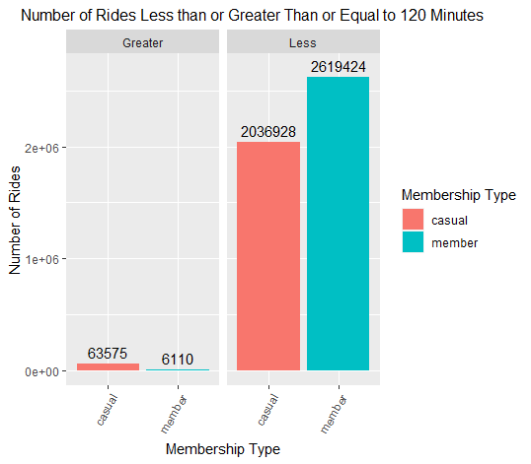
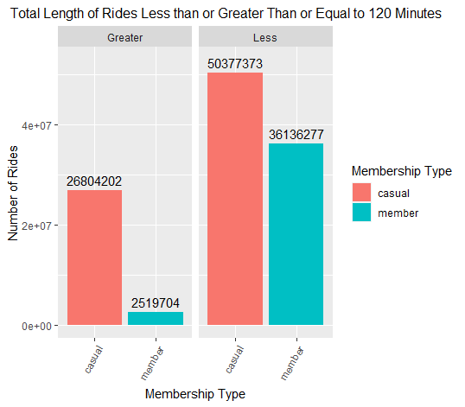
Less than 120 Minutes will be used as a Criteria to Compare Annual vs. Casual Riders
Noise - 3% of Casual Riders Account for 33% of Total Casual Ride Length – Dissimilar to ride length of Annual Riders
Better to focus on converting 97% of Casual riders, instead of the 3% who are massively different in ride length

Slide 8
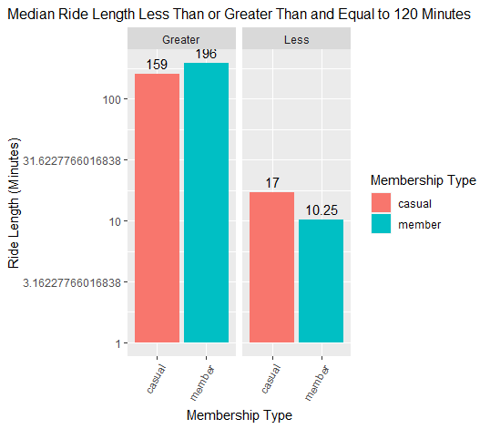
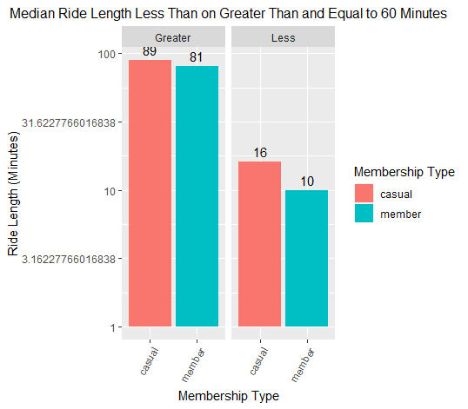
Similar Median Ride Length for Less than 120 and 60 Minutes Confirms 120 Minutes as a Better Range

Slide 9
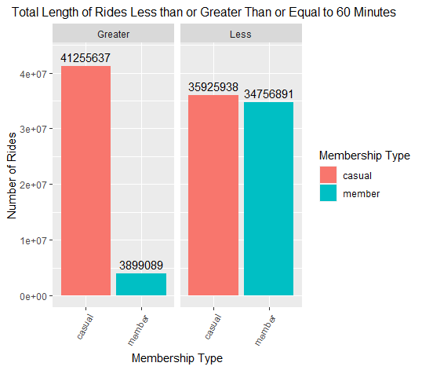
Using 60 Minutes as a Cutoff is a Bad Idea
>50% of Casual Rides > 60 Minutes
Therefore a lot of rides will be filtered out if 60 minutes is used as a filter
Want to convert and compare as many similar rides as possible

Slide 10
Understand how do Annual members and Casual riders use Cyclistic bikes differently
Main and Core Analysis
Filtering rides to focus on most impactful group
Specific – Combination of Variables
Caveats
Supplemental Analysis (Optional Viewing)
Broad Analysis – One Variable
Specific Analysis – Two Variables

Slide 11
Comparing mean, median, total ride length, and ride number via various variables
Combination of
Season
Month
Ride Type
Day of Week

Slide 12
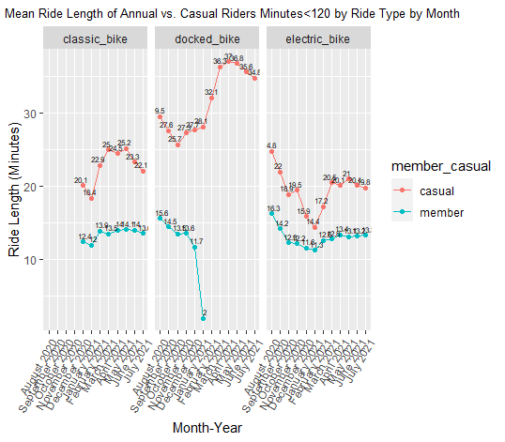

Greater Mean and Median of Casual Rides in All Ride Type Across All Months

Slide 13
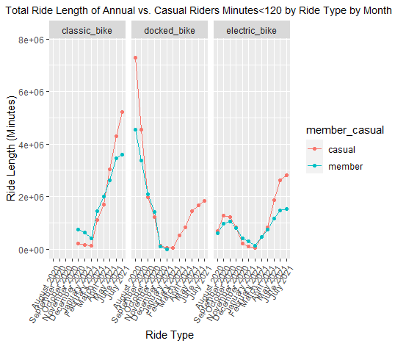
Total Ride Length for Annual vs. Casual Rides is Mostly the Same per Ride Type by Month
Greater ride length for Casual rides in May, June, and July for the classic and electric bike
Greater ride length for Casual rides in August and September for docked bikes
Transference, or cannibalization of docked bikes leads to no Annual members using docked bikes in February 2021

Slide 14
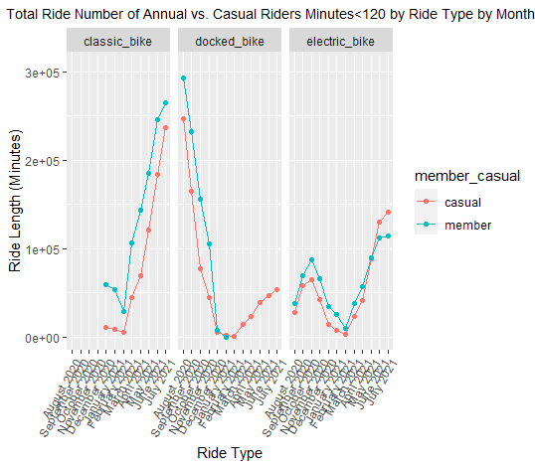
Greater Total Number of Annual Rides for All Bike Types Across Most Months
Holds true for the classic bike
True for Docked bikes until February 2021 because of transference, or cannibalization
True for electric bikes until June and July 2021

Slide 15
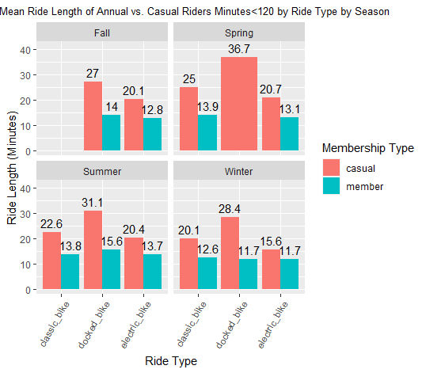
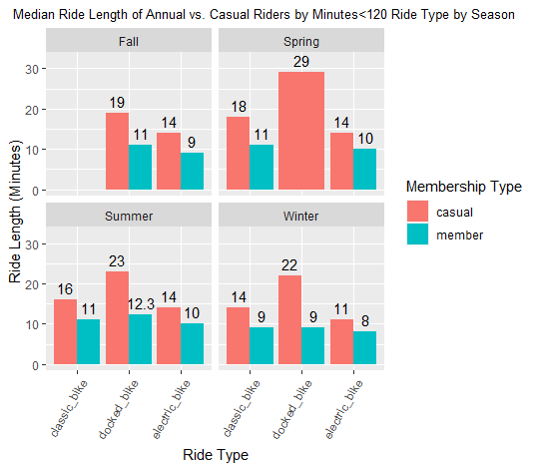
Greater Mean and Median of Casual Rides for All Ride Types Across All Seasons
Mean>Median shows mean values are skewed by a smaller percentage of rides above the median
Docked bikes most popular among casual rides, and classic bike most popular among Annual rides discounting docked bikes

Slide 16
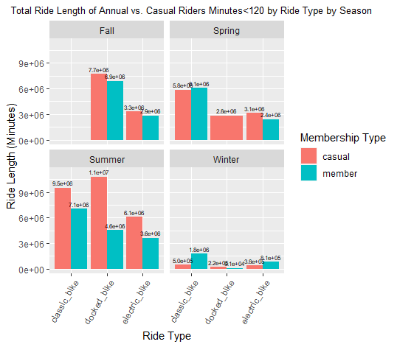
Greater Total Ride Length for Casual Rides for Most Ride Types for Most Seasons
Except Winter, where classic bikes and electric bikes are ridden more by Annual members
Winter rides are almost negligible due to low count
Exception in classic bikes in spring for Annual rides
Summer has the most rides for both membership types

Slide 17
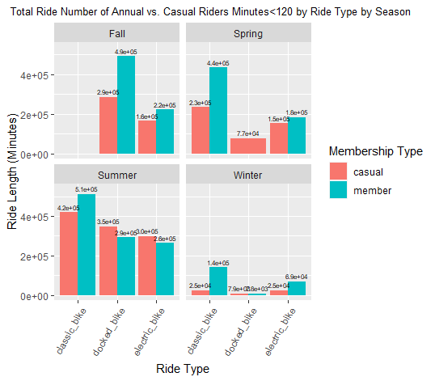
Greater Total Ride Number for Annual Rides for Most Ride Types for Most Seasons
Exception in docked bikes and electric bikes during Summer
Winter rides are almost negligible due to low count
Exception in docked bikes in Spring because of transference, or cannibalization of Annual rides
Summer has the most rides for both membership types

Slide 18
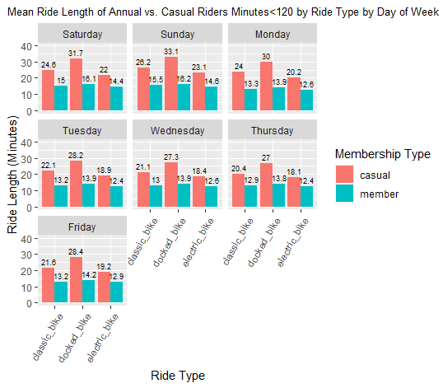
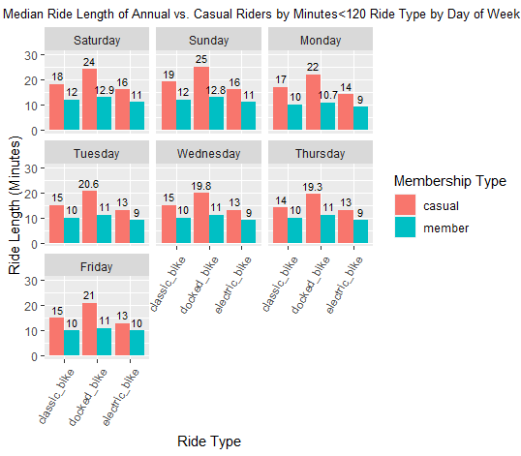
Greater Mean and Median of Casual Rides for All Ride Types Across All Days of the Week
Mean>Median shows mean values are skewed by a smaller percentage of rides above the median
Weekend mean and median is greater than weekday for both membership types

Slide 19
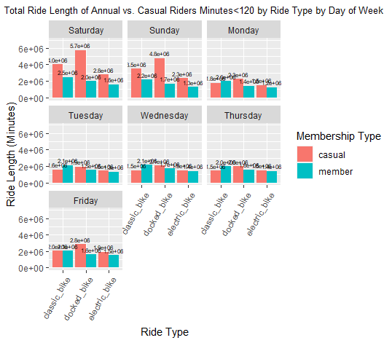
Greater Total Ride Length of Casual Rides on the Weekend for All Ride Types
Greater Total Ride Length for Annual Rides on Weekdays for classic bike
Greater Total Ride Length for Casual Rides on Weekdays for docked and electric bikes
Weekend Total Ride Length is highest for both groups on the weekend, though Casual Rides see a greater increase

Slide 20
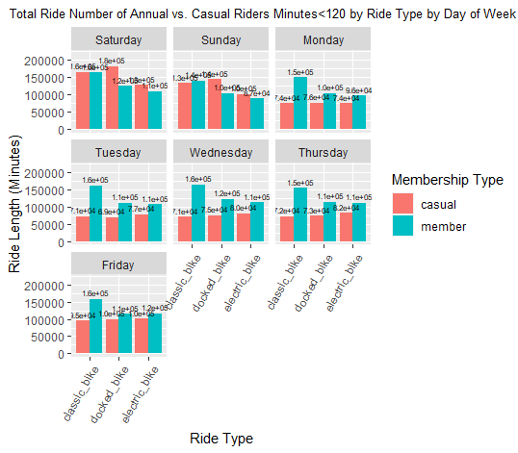
Greater Total Ride Number of Annual Rides for All Ride Types for All Weekdays
Casual Total Ride Number is greater on the weekend for docked and electric bikes
Annual Total Ride Number is greater on the weekend for classic bikes
Casual Total Ride Number are greatest on the weekend
Annual Total Ride Number is about the same for all ride types for all days of the week

Slide 21
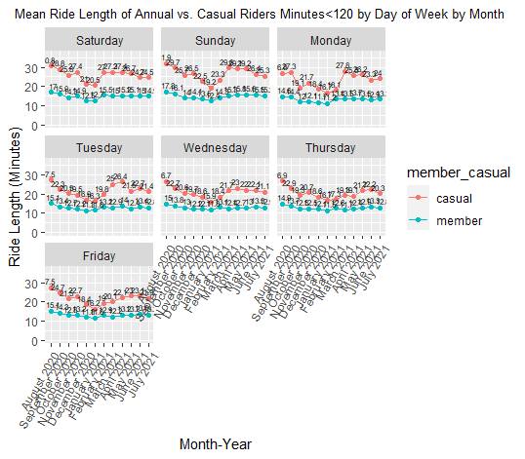
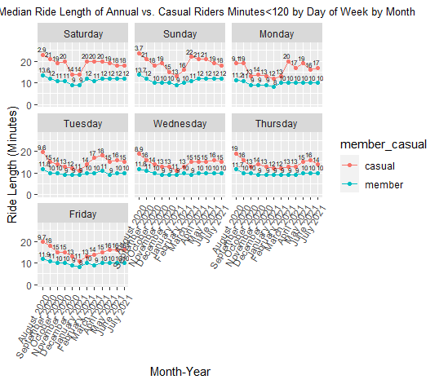
Greater Mean and Median of Casual Rides for All Days of the Week for All Months
Mean>Median shows mean values are skewed by a smaller percentage of rides above the median
Greater Mean and Median for both membership types on the weekend vs. the weekday

Slide 22
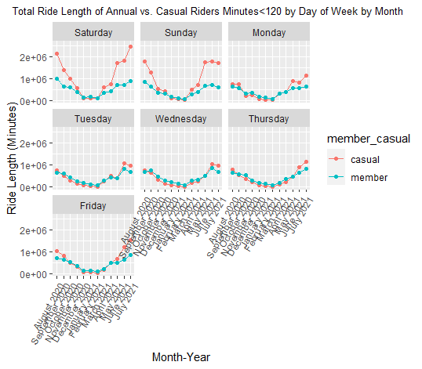
Total Ride Length is about the Same for Both Membership Types on Weekdays across Most Months
Exception: Casual Total Ride Length is greater for June and July 2021 for all Days of the Week
Total Ride Length on Weekend is the same for both membership types except for months: May, June, July, August, September, October
Casual Total Ride Length is greatest on the weekend
Both membership have more total ride length during warmer month (non-Winter)

Slide 23
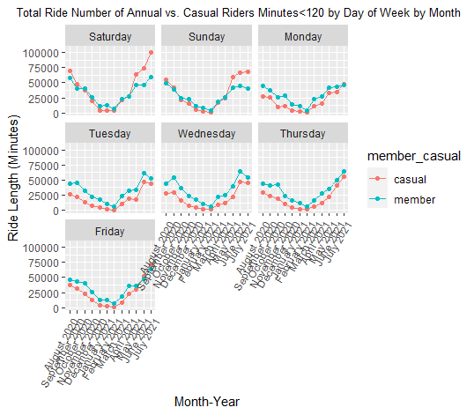
Greater Total Ride Number of Annual Rides on Weekdays for All Months
Exception: Casual Total Ride Number is greater on Friday for June and July 2021
Total Ride Number on Weekend is the same for both membership types except for months: May, June, July, August
Casual Total Ride Number are greatest on the weekend
Both membership have more total rides during warmer month (non-Winter)

Slide 24
Understand how do Annual members and Casual riders use Cyclistic bikes differently
Main and Core Analysis
Filtering rides to focus on most impactful group
Specific – Combination of Variables
Caveats
Supplemental Analysis (Optional Viewing)
Broad Analysis – One Variable
Specific Analysis – Two Variables

Slide 25
Caveat
Unique individual rider data – churn rate, patterns, demographics
Need to look at data across a greater time period
Need Qualitative Data - Social/group activity? If so, what is the effect on engagement

Slide 26
Conclusion
Greater mean and median ride length of Casual rides for almost all combination of variables
Generally, greater number of Annual rides, but greater total ride length of Casual rides across various combination of variables
Classic bikes are the most popular among Annual rides, while docked bikes have higher engagement for Casual rides
Casual rides have much more engagement during the weekend, while Annual rides are slightly more engaged during the weekend

Slide 27
Understand how do Annual members and Casual riders use Cyclistic bikes differently
Main and Core Analysis
Filtering rides to focus on most impactful group
Specific – Combination of Variables
Caveats
Supplemental Analysis (Optional Viewing)
Broad Analysis – One Variable
Specific Analysis – Two Variables

Slide 28
Annual Member vs. Casual Riders Patterns - Broad
Broad Differences between Annual vs. Casual Riders
By Total Number of Rides
By Month
By Season
By Day of Week
By Ride Type
By Time

Slide 29
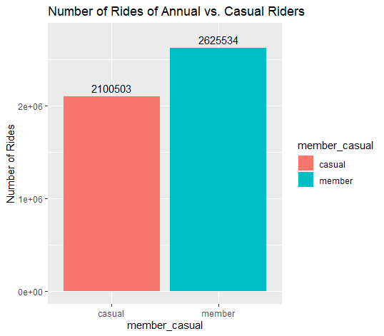
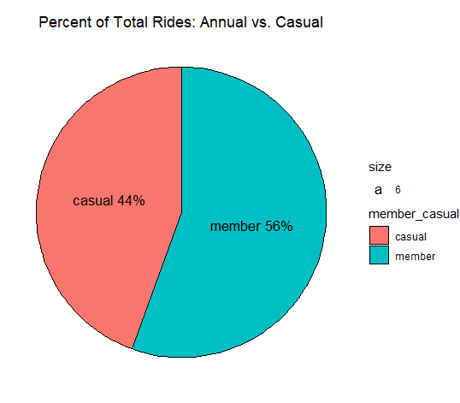
Greater Number of Annual Rides Compared to Casual Rides
Total Rides

Slide 30
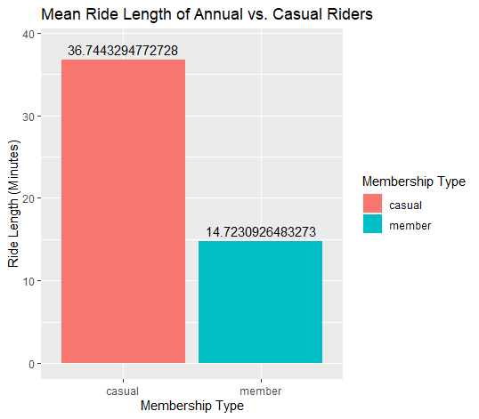
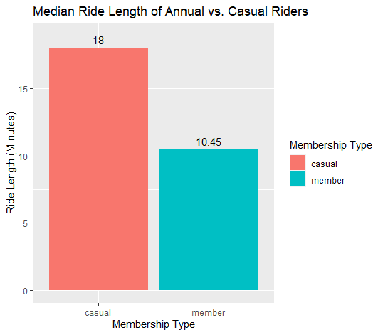
Mean and Median Ride Length of Casual Rides is Greater than their Annual Rides Counterpart
Mean>Median shows mean values are skewed by a smaller percentage of rides above the median
Although there are less Casual rides, the average and median Casual ride is longer than the average and median Annual ride
Ride Length

Slide 31
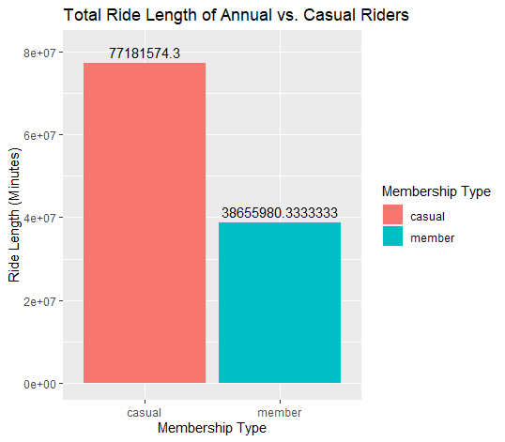
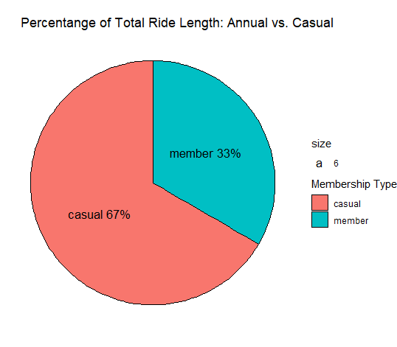
Total Casual Ride Length is Twice as much as Total Member Ride Length
Total ride time of Casual rides are >2x than total ride time of Annual rides
Ride Length

Slide 32
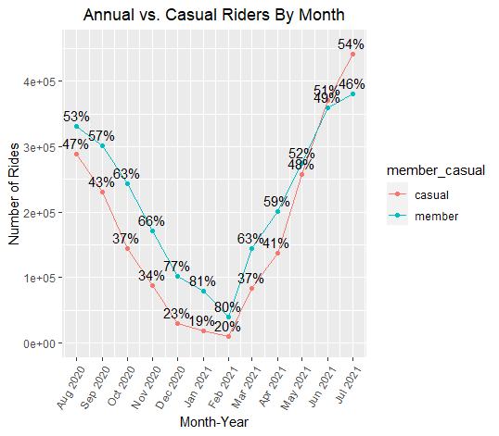
More Annual Rides vs. Casual Rides per Month in Most Months
June and July are the exceptions
Total Rides ~ Month

Slide 33
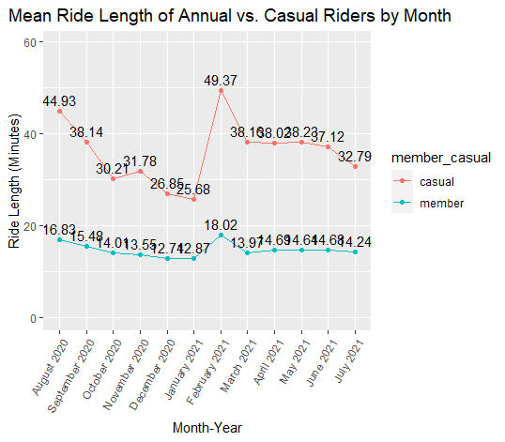
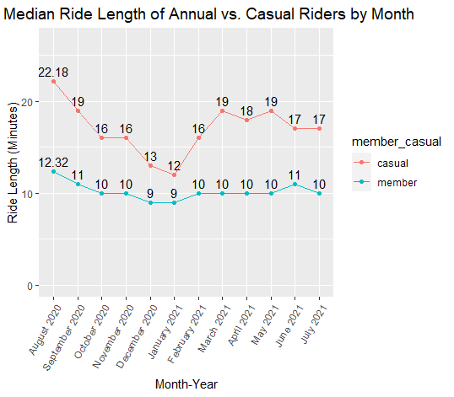
Greater Mean and Median of Casual Rides in All Months
Longer Engagement across all months by Casual Rides
Mean>Median shows mean values are skewed by a smaller percentage of rides above the median
Ride Length ~ Month

Slide 34
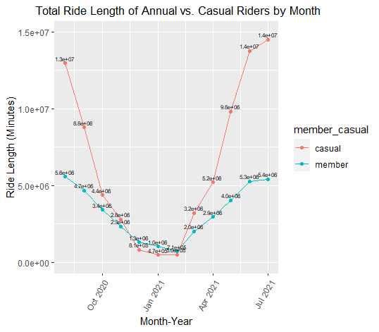
Greater Total Ride Length of Casual Riders in Most Months
December, January, and February are the exceptions
More Annual Rides in these months is suggestive that either more Annual members or Annual members are more willing to brave the cold, albeit for a shorter time
Ride Length ~ Month

Slide 35
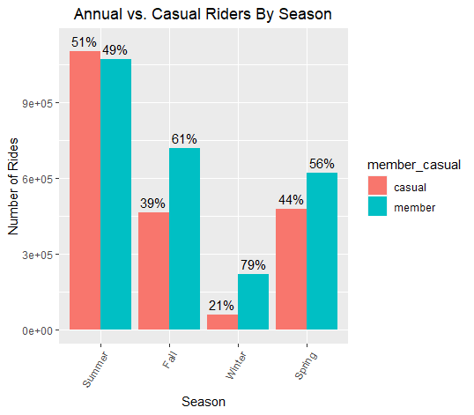
Greater Number of Annual Rides vs. Casual Rides in All Seasons Except for Summer
Most pronounced difference between member type is in the Winter months
Greatest number of rides in Summer for both membership types
Total Rides ~ Season

Slide 36
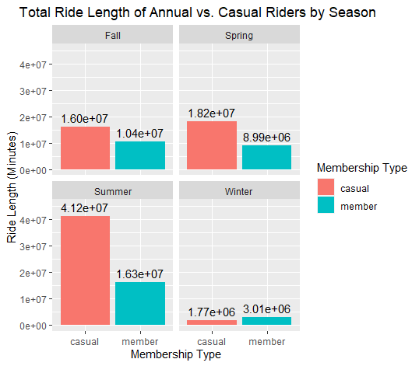
Greater Total Ride Length of Casual Riders in Most Seasons
Winter is the only exception
Winter months (December, January, and February) also have a lower total ride length from Casual rides
Results from Seasons aligns with results from Months
Ride Length ~ Season

Slide 37
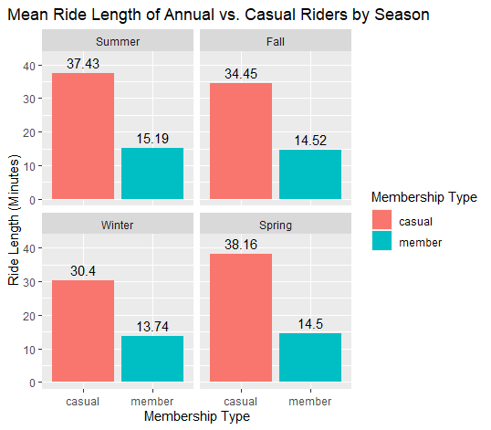
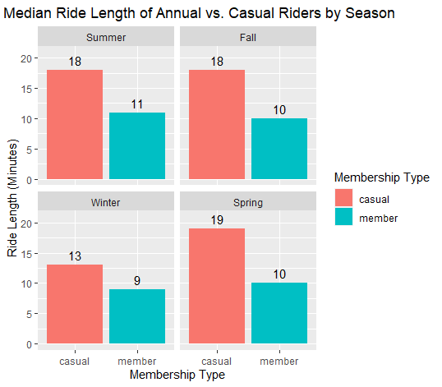
Greater Mean and Median of Casual Rides in All Seasons
Mean>Median shows mean values are skewed by a smaller percentage of rides above the median
Longer Engagement across all seasons by Casual Rides
Ride Length ~ Season

Slide 38
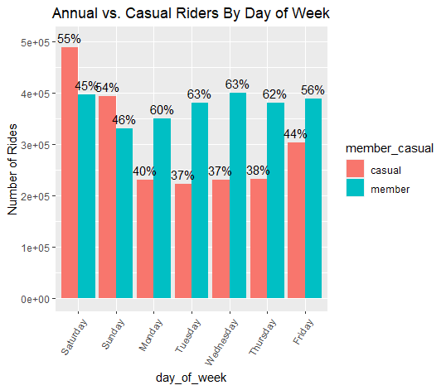
Greater Number of Annual Rides on Weekday Greater Number of Casual Rides on Weekend
Saturday has the most total rides
Casual rides on Saturday account for the most single day and group total
Suggestive of Casual riders having more time on the weekend to ride, and/or more free/willing to ride on the weekends
Total Rides ~ Day of Week

Slide 39
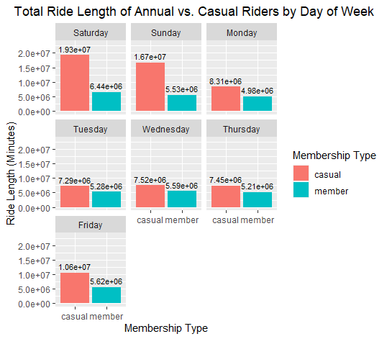
Greater Total Ride Length of Casual Riders Across All Days of the Week
Both membership types have more total ride length on weekends
Casual Rides’ total length is double on the weekend vs. weekday
While Annual Rides’ total length are only slightly up on the weekend
Suggestive of Casual riders having more time on the weekend to ride, and/or more free/willing to ride on the weekends
Ride Length ~ Day of Week

Slide 40
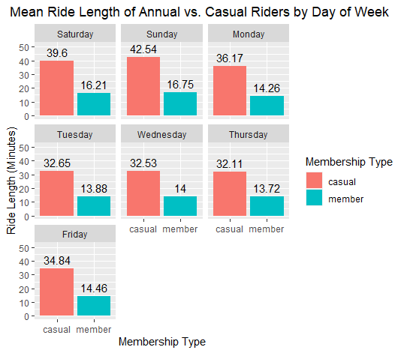
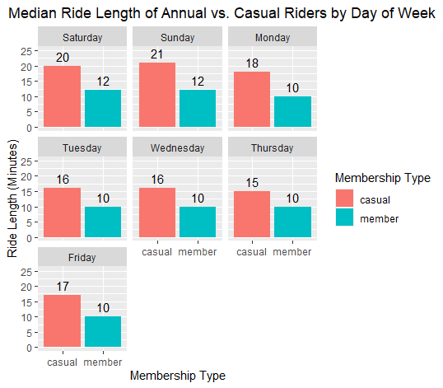
Greater Mean and Median of Casual Rides Across All Days of the Week
Mean>Median shows mean values are skewed by a smaller percentage of rides above the median
Greater mean and median for both membership types on the weekend
Greater increase in mean and median on the weekend for casual rides vs. Annual rides
Ride Length ~ Day of Week

Slide 41
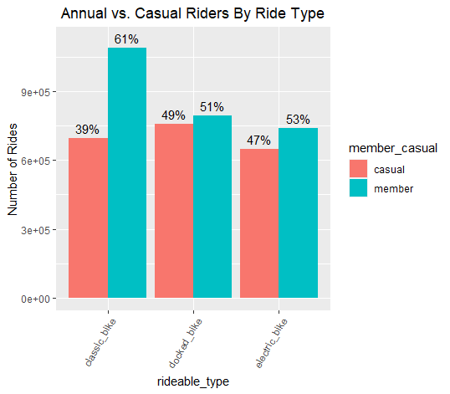
Greater Number of Annual Rides vs. Casual Rides Across All Ride Types
The Classic Bike was introduced starting December 2020
Greatest difference within ride type is in the classic bike group
Total Rides ~ Ride Type

Slide 42
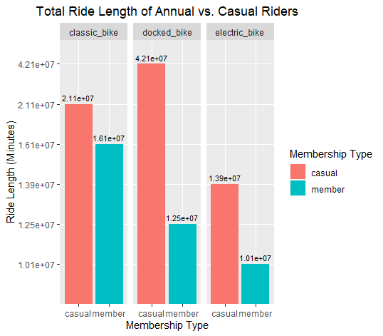
Greater Mean and Median of Casual Rides Across All Ride Types
Introduction of the classic bike causes the greatest difference of total ride length within ride type of the docked bike group
Suggestive of Annual members switching over to the classic bike
Ride Length ~ Ride Type

Slide 43
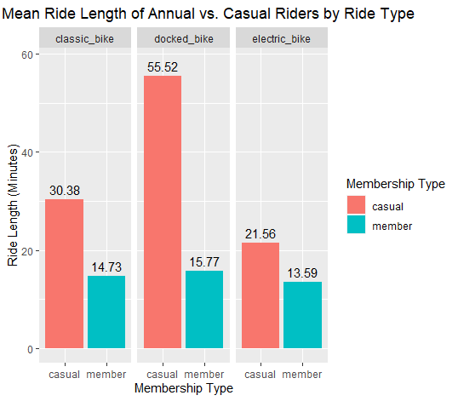
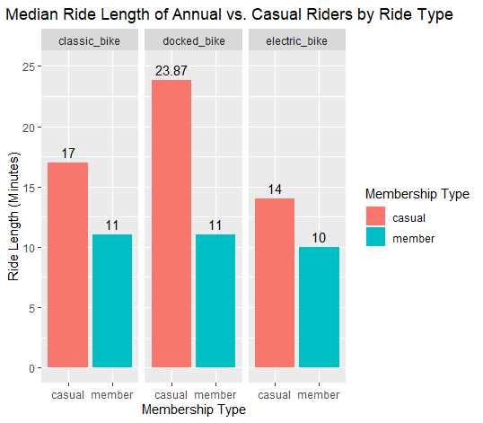
Greater Mean and Median of Casual Rides Across All Ride Type
Mean>Median shows mean values are skewed by a smaller percentage of rides above the median
Casual Members have longer engagement with docked bikes
Ride Length ~ Ride Type

Slide 44
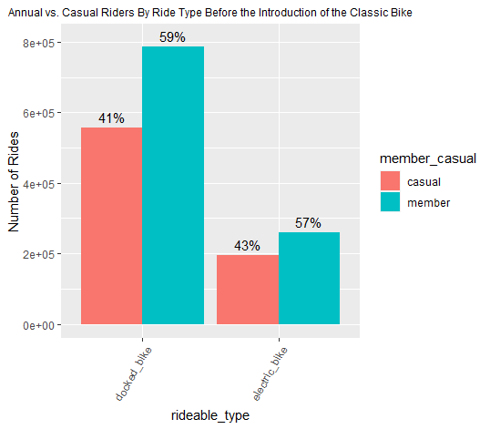
Greater Number of Annual Rides vs. Casual Rides Across All Ride Types Before the Classic Bike
Docked bikes are rode more for both groups
Greatest difference within ride type is in the docked bike group
Ride Type

Slide 45
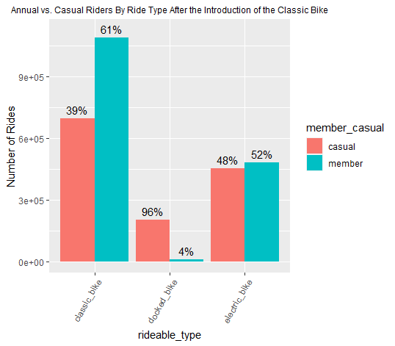
Greater Number of Annual Rides vs. Casual Rides Across All Ride Types After the Classic Bike
Classic bikes are rode more for both groups
Greatest difference within ride type is in the docked bike group - Docked are almost nonexistent among Annual riders
Seems some casual rides have transferred from docked bike to classic bike
Ride Type

Slide 46
Conclusion for Supplemental Broad Analysis
Greater engagement and total ride length of Casual rides across all variables
Greater Number of Annual Rides across all variables, except for docked bikes after the introduction of the classic bike → cannibilziation

Slide 47
Understand how do Annual members and Casual riders use Cyclistic bikes differently
Main and Core Analysis
Filtering rides to focus on most impactful group
Specific – Combination of Variables
Caveats
Supplemental Analysis (Optional Viewing)
Broad Analysis – One Variable
Specific Analysis – Two Variables

Slide 48
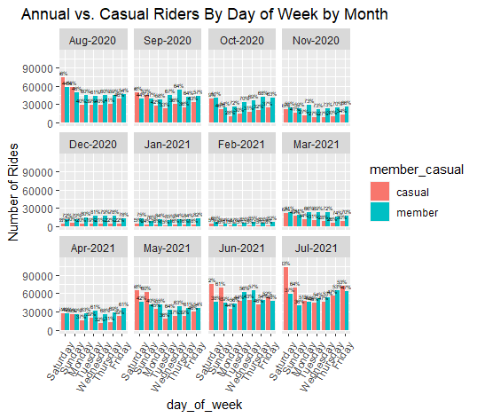
Greater Number of Rides by Annual Riders for Most Days of the Week across all Months
The only time Casual riders have more rides are during Friday, Saturday, or Sunday in the warmer months: May, June, July, August, September
Day of Week ~ Month

Slide 49
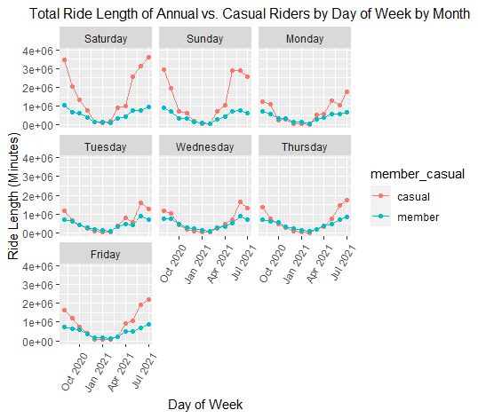
Greater Total Ride Length of Casual Rides for All Days of the Week across Summer and Spring Months
Greater Total Ride Length of Annual Rides for All Days of the Week across Winter and some Fall Months albeit Annual Rides remain mostly constant for each Day of the Week
Ride Length ~ Day of Week ~ Month

Slide 50
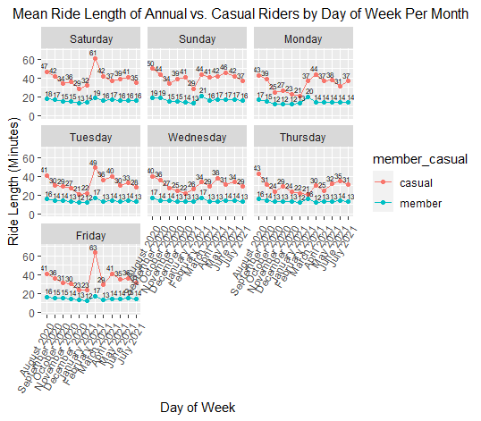
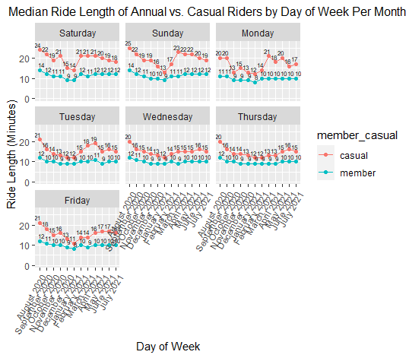
Greater Mean and Median of Casual Rides Across All Days of the Week Among All Months
Mean>Median shows mean values are skewed by a smaller percentage of rides above the median
Greater mean and median for both membership types on the weekend
Greater increase in mean and median on the weekend for casual rides vs. Annual rides
Ride Length ~ Day of Week ~ Month

Slide 51
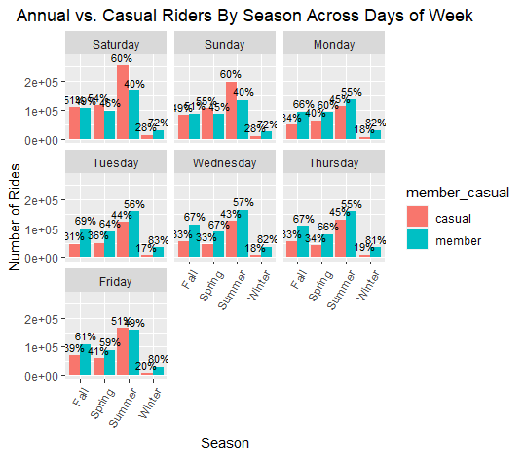
Generally Greater Number of Annual Rides on Weekday Generally Greater Number of Casual Rides on Weekend Across Seasons
Greater number of Annual rides across all days of week in Winter
Greatest difference in percentage of rides across all days of week in Casual
Total Rides ~ Day of Week ~ Season

Slide 52
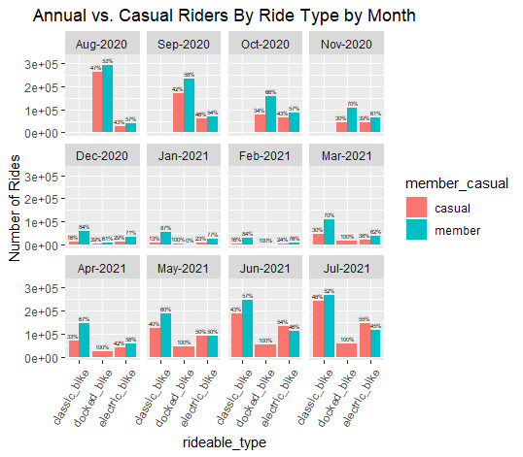
Usually, More Annual Riders per Ride Type Across all Months
Electric bikes in June and July are the exception
Docked bike was the most popular among Annual riders until December 2020, the introduction of the classic bike
There are more Casual riders on the docked bike starting in January 2021 as it seems all the docked bike riders switched to the classic bike
Total Rides ~ Ride Type ~ Month

Slide 53

Greater Casual Total Ride Length in Non- Winter Seasons Across Most Ride Types
Greater Casual total ride length vs. Annual counterpart is greatest among docked bikes
Winter Months have a lot lower total ride length, making patterns in Winter seem almost negligible
Ride Length ~ Ride Type ~ Month

Slide 54


Greater Mean and Median of Casual Rides Across All Ride Types and Months
Mean>Median shows mean values are skewed by a smaller percentage of rides above the median
Docked bike’s mean and median ride length is greatest among ride type between both membership type
Median ride length of docked bikes of Annual rides suggest that in decline of docked bikes may have transferred ride time to classic and electric bikes
Ride Length ~ Ride Type ~ Month

Slide 55

Classic and Electric Bike is Used Most by Annual Riders in Three Seasons
Classic bike has a greater number of rides in all three seasons it is available.
Electric bike has more Annual rides in all seasons except for Summer
Docked bike has more casual riders in 3 season, Fall being the only exception, before the introduction of the electric bike, when Annual members using the docked bike likely switched over
Total Rides ~ Ride Type ~ Season

Slide 56

Greater Total Ride Length of Casual Rides in All Seasons Except Winter Across All Ride Types
Even with the transfer of ride time from Annual rides docked bikes to classic and electric bikes, Casual total rides length is still longer
Winter Months have a lot lower total ride length, making patterns in Winter seem almost negligible
Ride Length ~ Ride Type ~ Season

Slide 57


Greater Mean and Median of Casual Rides Across All Ride Types and Seasons
Mean>Median shows mean values are skewed by a smaller percentage of rides above the median
Even though Annual rides on the docked bike was cannibalized, classic and electric bike engagement is higher for Casual rides
Docked bikes have highest engagement with Casual rides, while classic bikes have highest engagement with annual rides (excluding docked bikes)
Ride Length ~ Ride Type ~ Season

Slide 58

Greater Number of Annual Rides on Weekday Generally Greater Number of Casual Rides on Weekend Across Ride Types
The Classic Bike has the most skewed ridership in favor of the Annual members across all ride types per each day of the week even after debuting in December 2020
Total Rides ~ Ride Type ~ Day of Week

Slide 59

Greater Total Casual Ride Length for Most Ride Types Across Most Days of the Week
Weekend total Casual ride length for all ride types increases from the weekday more than the increase for its Annual counterpart
Weekend Casual docked bike, primarily, and weekend classic bike and Friday docked bike, secondarily, have highest ride lengths per grouping, suggesting Casual rides are more frequent/longer and aligned with work off lifestyle
Tuesday, Wednesday, and Thursday Casual classic bike have a lower total ride length than their Annual counterparts
Ride Length ~ Ride Type ~ Day of Week

Slide 60


Greater Mean and Median of Casual Rides Across All Ride Types and Day of Week
Mean>Median shows mean values are skewed by a smaller percentage of rides above the median
Most engagement for all ride and membership types on weekend
Ride Length ~ Ride Type ~ Day of Week

Slide 61
Conclusion for Supplemental Specific Analysis
Generally, more total rides by Annual members, but less total ride length, average, and median ride length (engagement)
Possible transference of Annual members from the docked bike to the classic bike (cannibalization)
On weekends Casual Riders ride longer and more rides

Slide 62
Actions
1. Collect and analyze more specific data
2. Test promotions to see if they increase conversion and churn rate
3. Hold events for greater conversion and stickiness
4. Market cycling as a social activity

